Slide 1
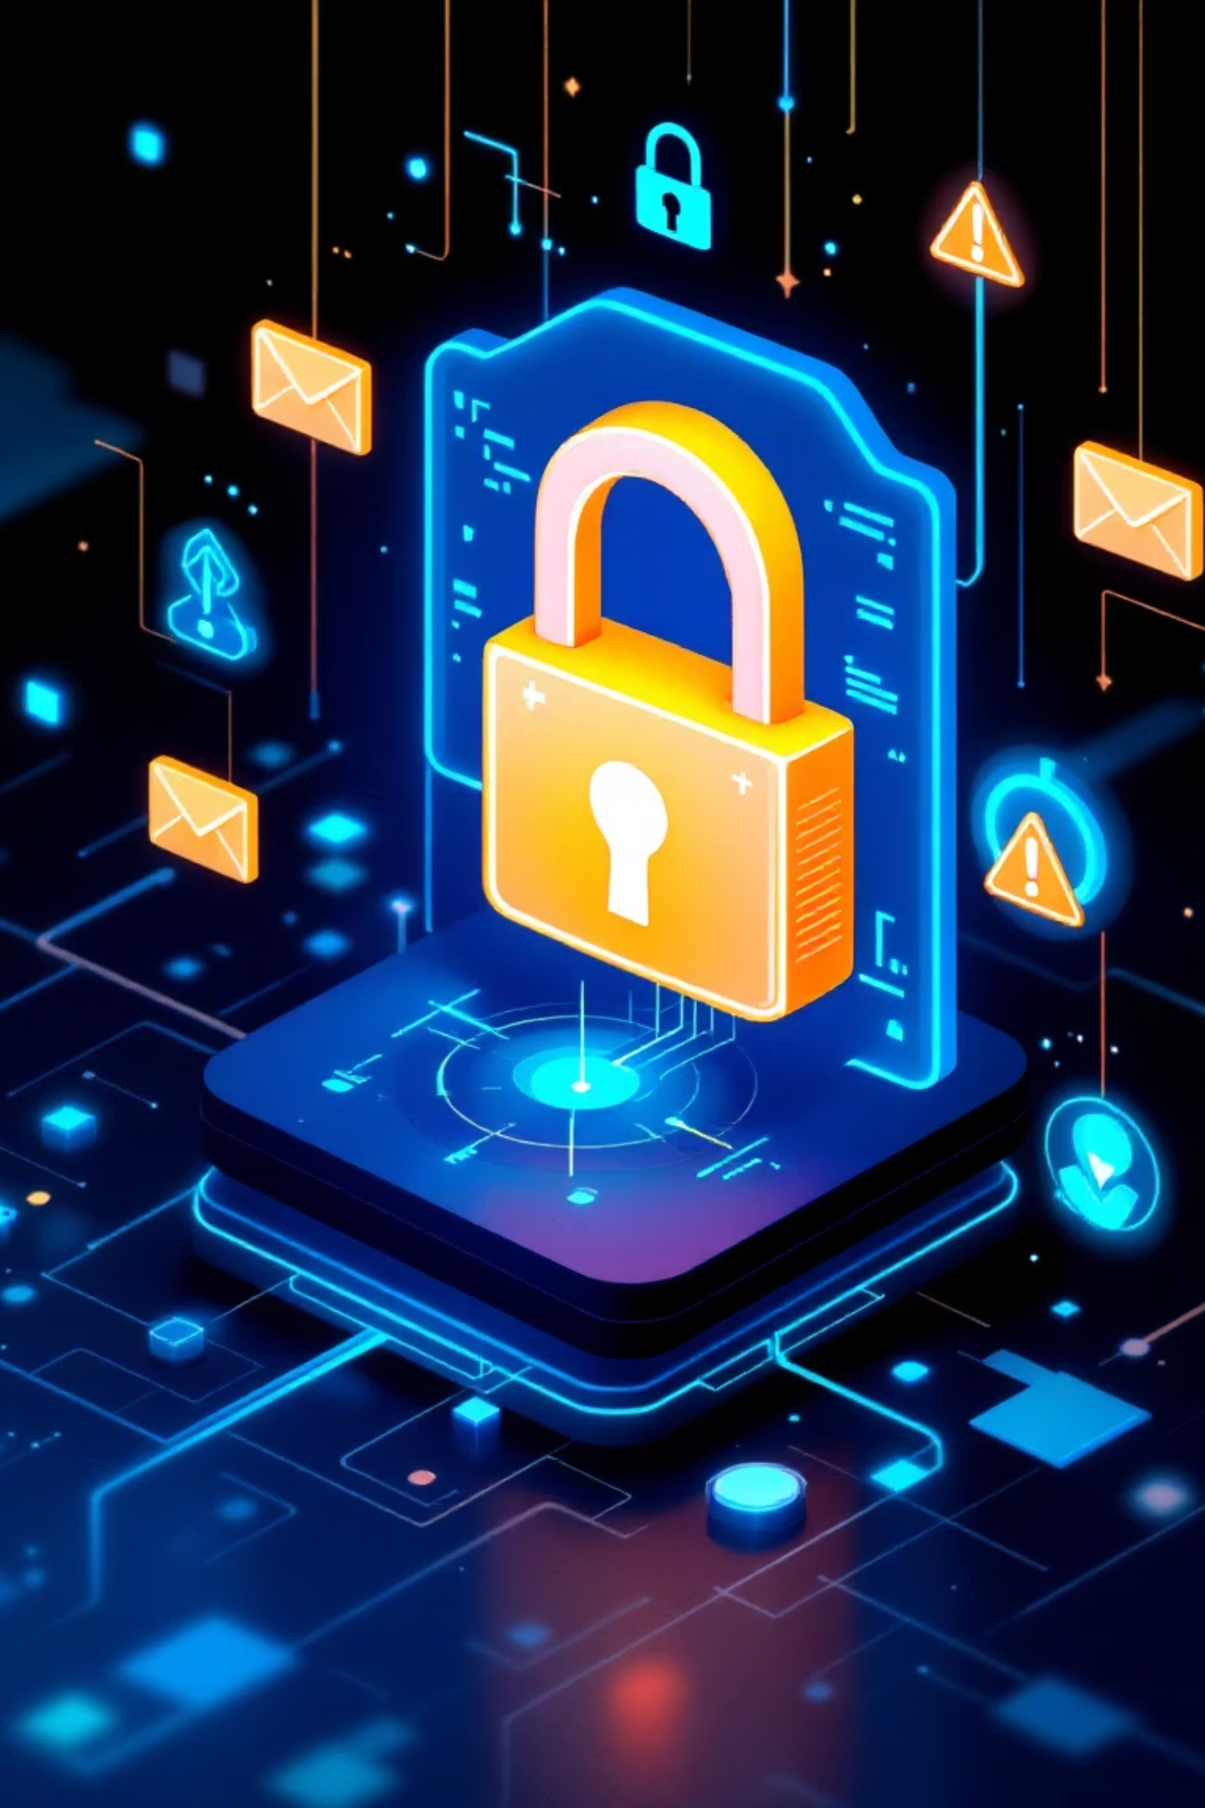
Phishing Awareness Training
Recognize • Prevent • Protect
Made by Badar

Slide 2

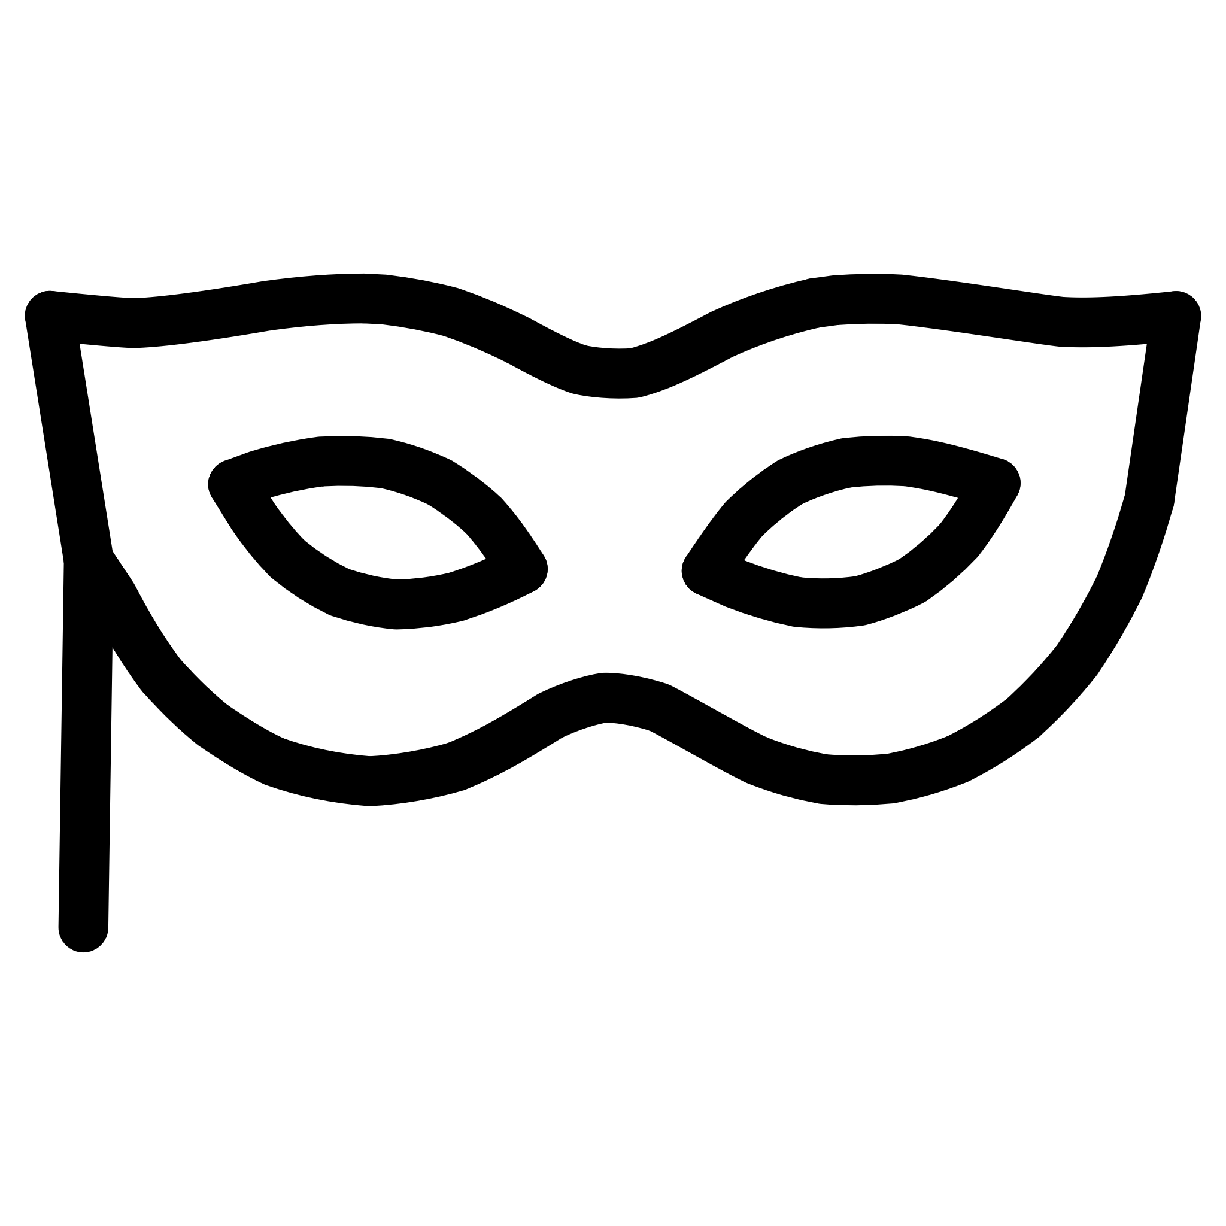


What Is Phishing?
Phishing is a deceptive cyberattack where malicious actors attempt to trick individuals into revealing sensitive information or performing actions that compromise security. Attackers often masquerade as trustworthy entities to gain your confidence.
Deceptive Tactics
Information Targeted
Attackers use psychological manipulation to bypass security measures, exploiting human trust and curiosity.
Commonly sought data includes login credentials, financial details, and personal identification numbers.
Consequences
Successful phishing can lead to identity theft, financial loss, and severe data breaches for individuals and organizations.
Made by Badar

Slide 3
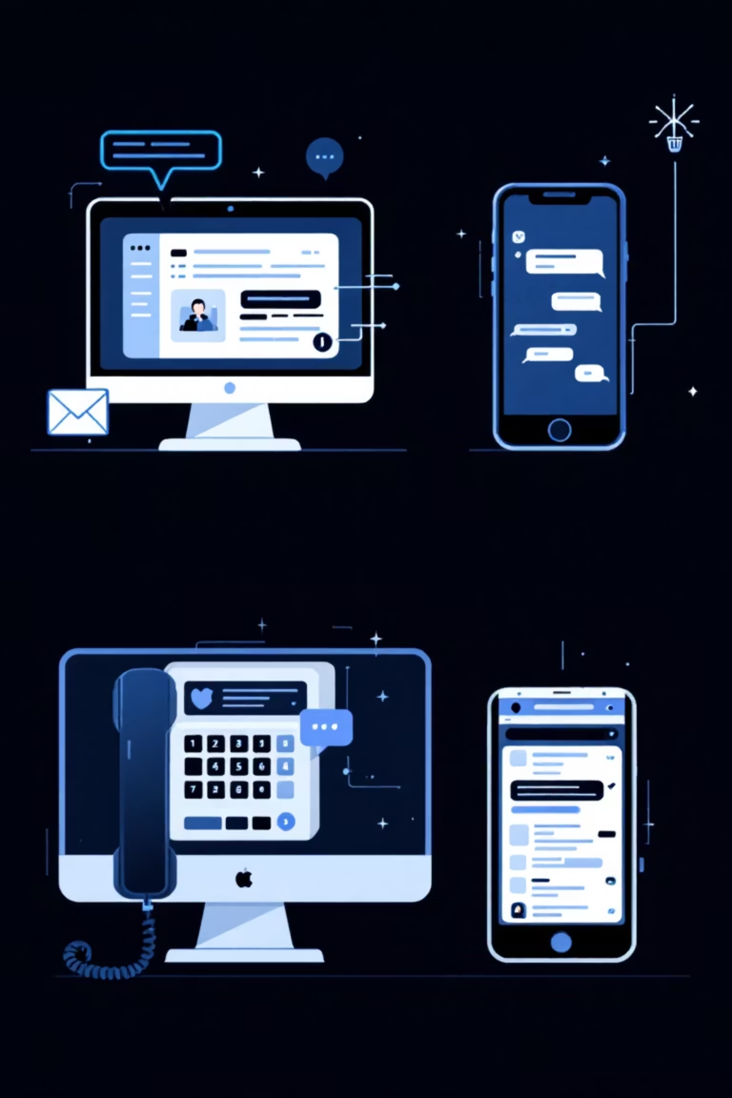

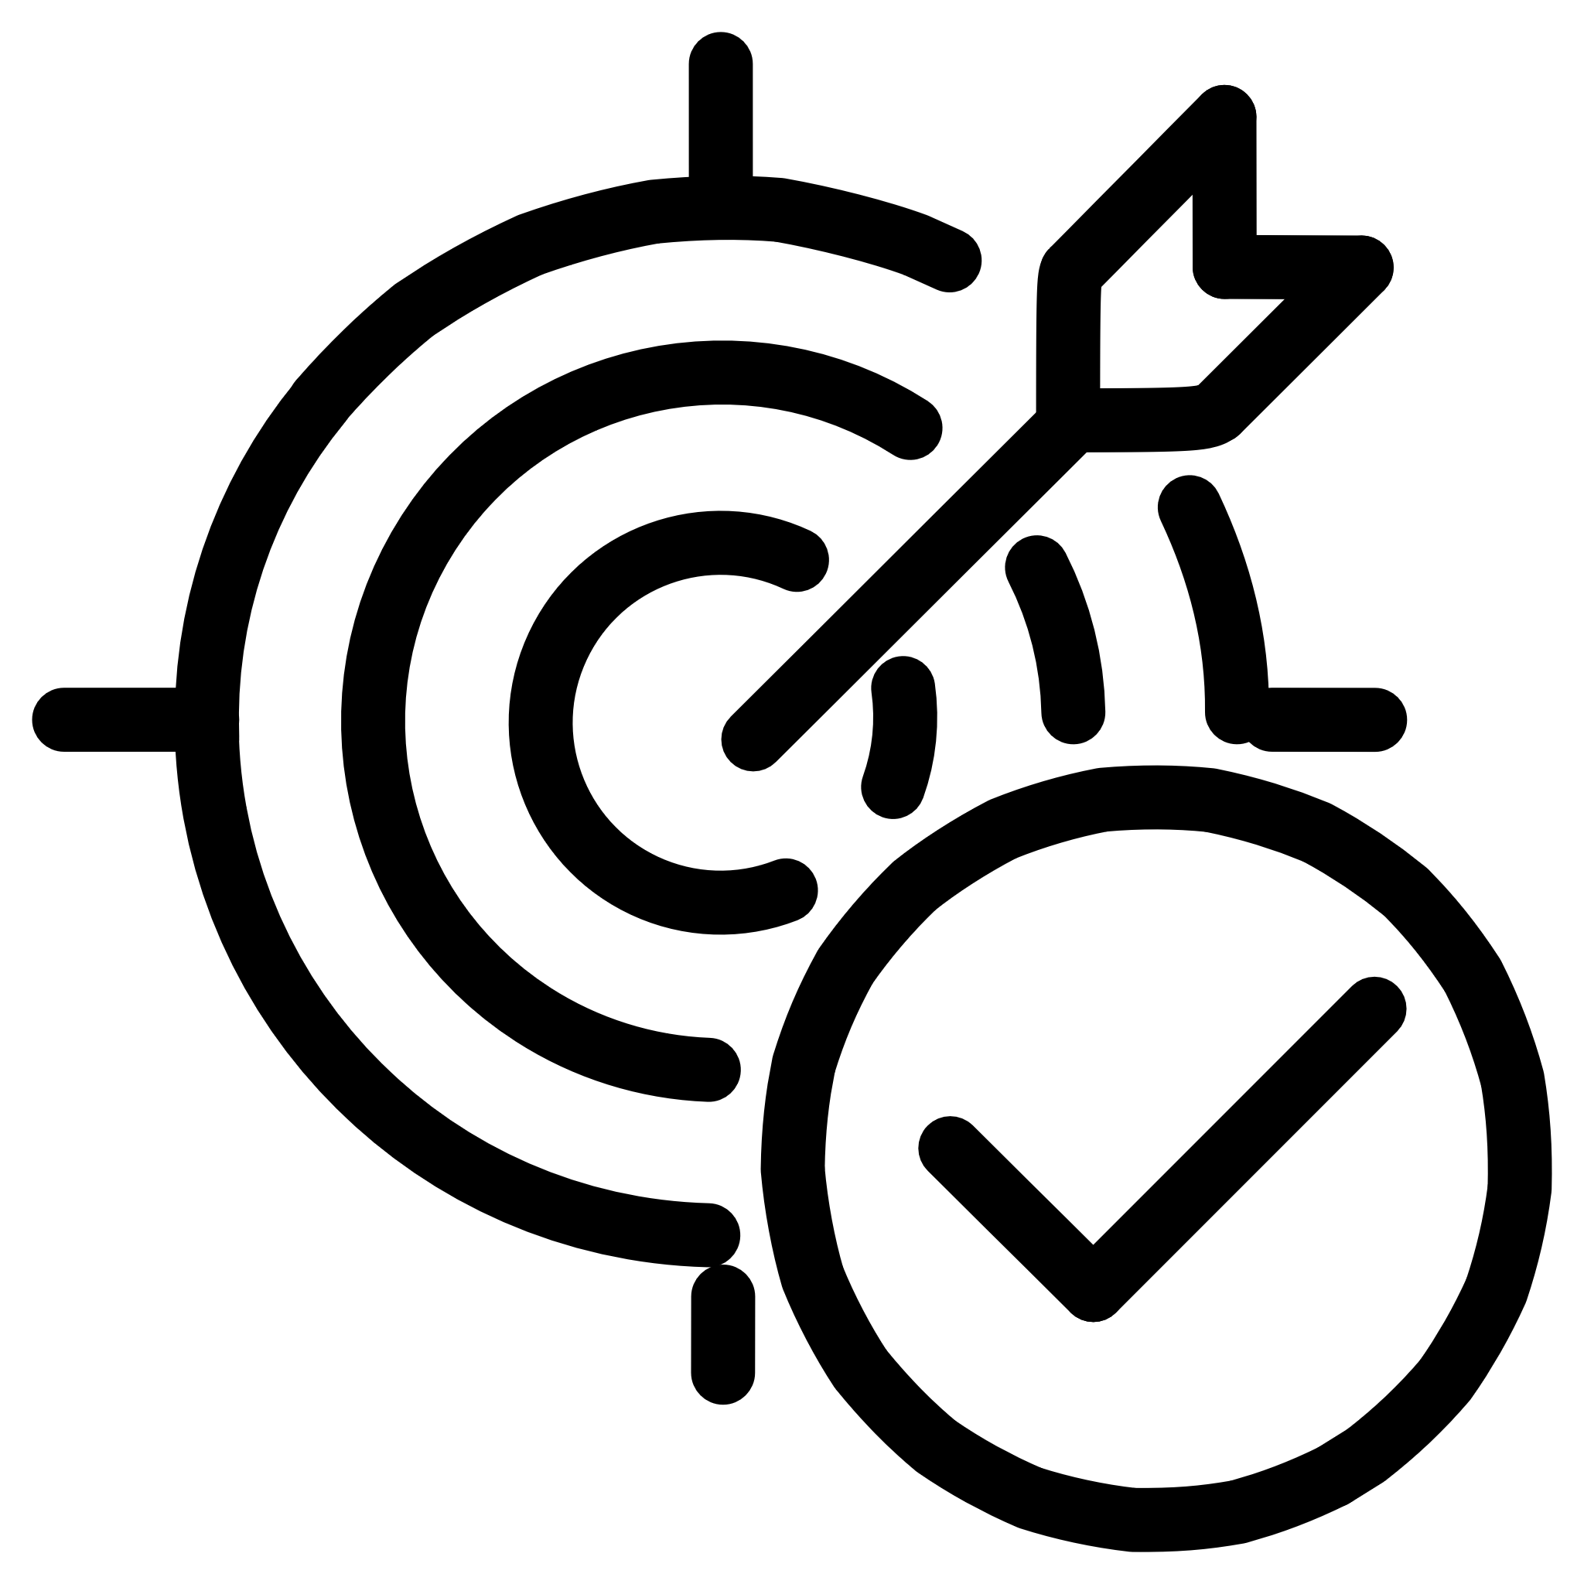


Common Phishing Attack Types
Phishing isn't just about emails anymore. Attackers use various communication channels to ensnare their
targets.
Email Phishing
The most common form, using fake emails to lure recipients into clicking malicious links or downloading
infected attachments.
Spear Phishing
Highly targeted attacks customized for specific individuals or organizations, making them harder to
detect.
Smishing (SMS)
Phishing attempts conducted via text messages, often containing links to fake websites or requests for
personal data.
Vishing (Voice)
Phishing over voice calls, where attackers impersonate legitimate entities to extract sensitive
information.
Made by Badar

Slide 4
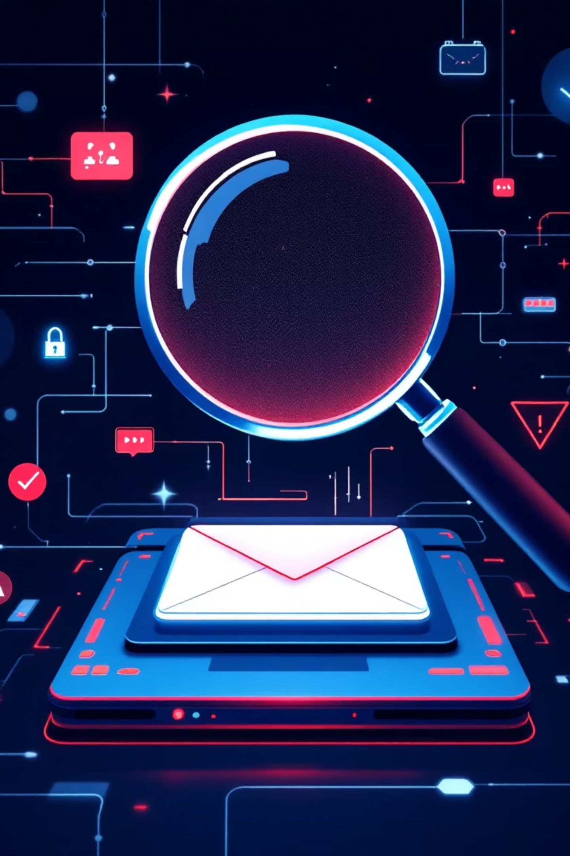

Red Flags in Phishing Emails
Learning to spot the subtle indicators of a phishing email is your first line of defense. Pay close attention to these common signs.
Suspicious Sender Addresses
Look for unusual domains, misspelled names, or addresses that don't match the purported sender.
Urgent or Threatening Messages
Attackers often create a sense of panic or urgency, threatening account suspension or legal action to rush your decision.
Unexpected Attachments or Links
Hover over links to see the actual URL. Be wary of unsolicited attachments, especially if they end in .exe, .zip, or .js.
Spelling and Grammar Mistakes
Professional organizations rarely send out communications riddled with errors. This is a tell-tale sign of a scam.
Made by Badar

Slide 5
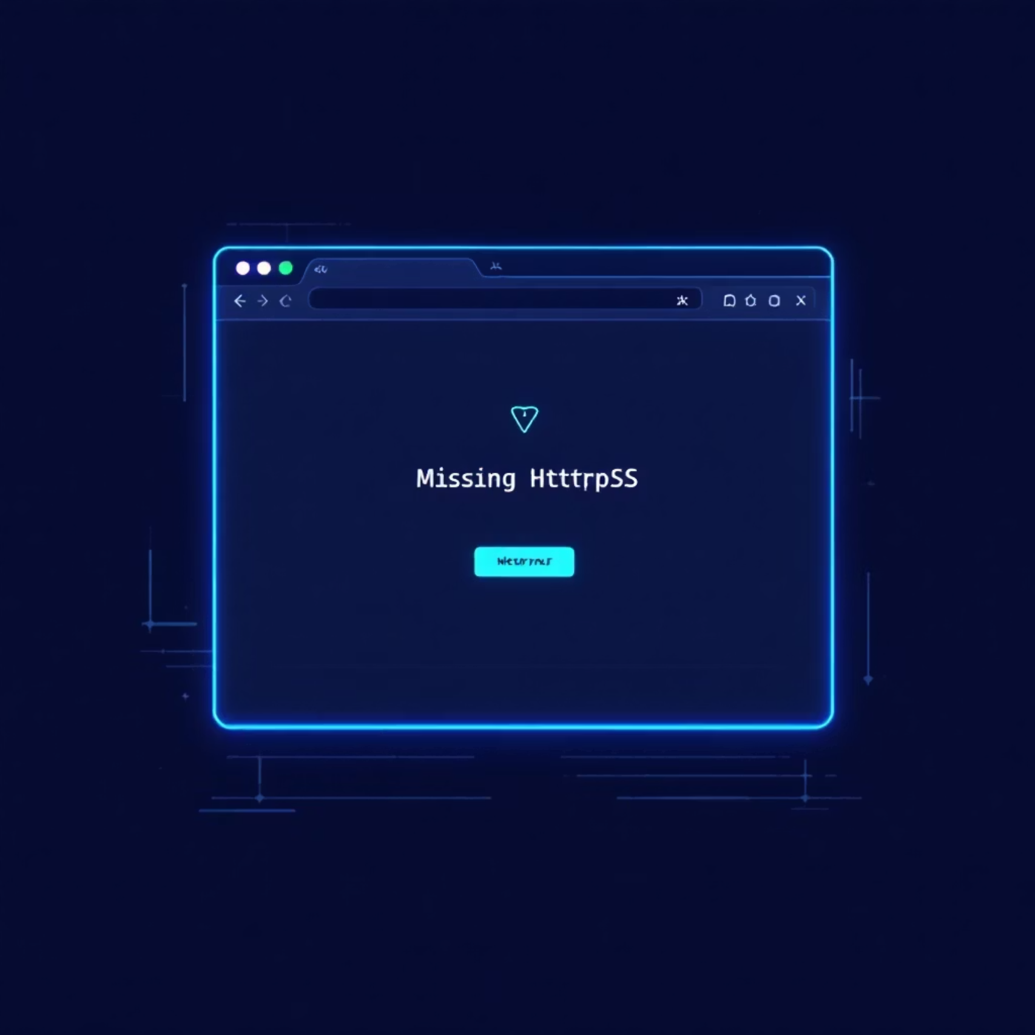
Identifying Fake Websites
Phishing often leads to fake websites designed to steal your credentials. Knowing how to scrutinize a website's authenticity is crucial.
Misspelled or Look-Alike URLs: Attackers register domains that are slightly different from legitimate ones (e.g., "bankofamerica.com" vs. "bank0famerica.com").
No HTTPS or Security Warnings: Always check for "https://" and the padlock icon in the address bar. A missing "s" or a security warning indicates an unsafe site.
Poor Website Design: Legitimate companies invest in professional web design. A poorly designed, low-resolution, or inconsistent site can be a red flag.
Requests for Sensitive Information: Be suspicious if a website asks for an unusual amount of personal or financial data, especially outside of a secure login portal.
Made by Badar

Slide 6








Social Engineering Explained
Social engineering is the art of manipulating people into performing actions or divulging confidential information. It's often the human element, not technology, that attackers exploit.
Psychological Tactics
Manipulating Trust
Attackers leverage human psychology, using persuasion and trust to bypass technical safeguards.
They build rapport or impersonate trusted individuals to gain access or information.
Information Extraction
The Human Factor
The ultimate goal is to trick individuals into unknowingly compromising security.
Humans are often the weakest link in security, making education and awareness paramount.
Made by Badar

Slide 7
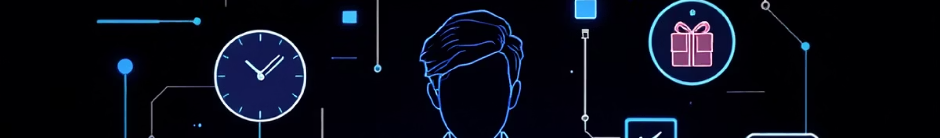




Social Engineering Tactics
Attackers employ a range of sophisticated psychological tactics to exploit human vulnerabilities. Recognizing these can help you avoid becoming a victim.
Fear and Urgency
Authority Impersonation
Creating a sense of immediate danger or a limited-time offer to pressure victims into hasty decisions.
Posing as someone in a position of power (e.g., CEO, IT support, government official) to demand compliance.
Curiosity or Rewards
Trust and Familiarity
Enticing victims with promises of exclusive content, prizes, or irresistible deals.
Leveraging existing relationships or impersonating known contacts to lower a victim's guard.
Made by Badar

Slide 8
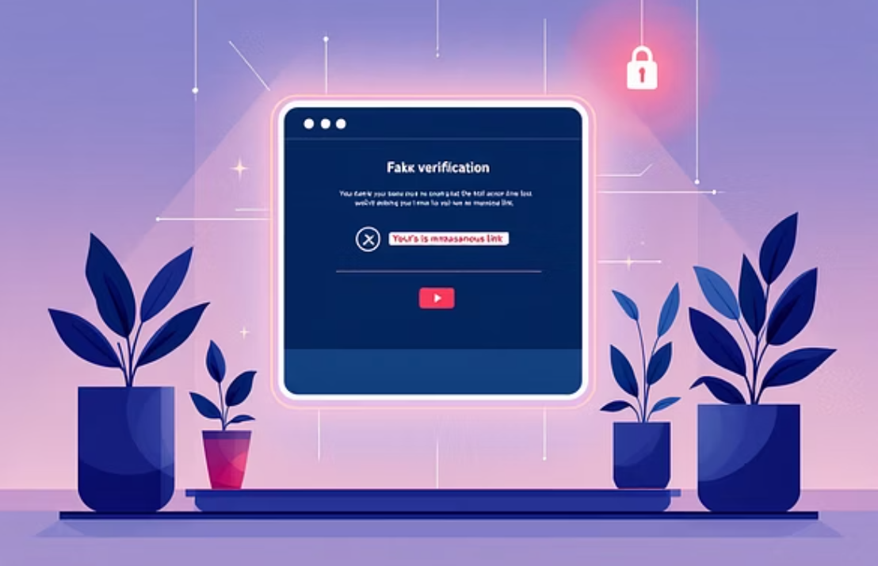
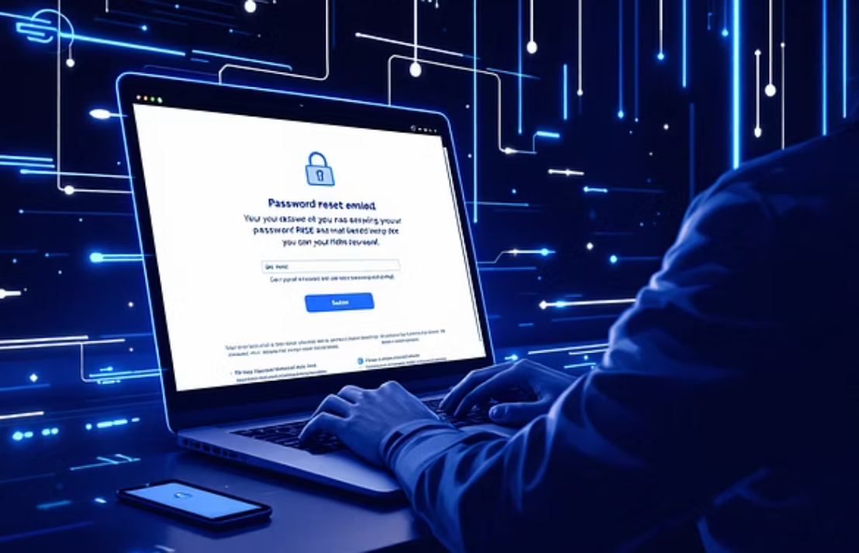
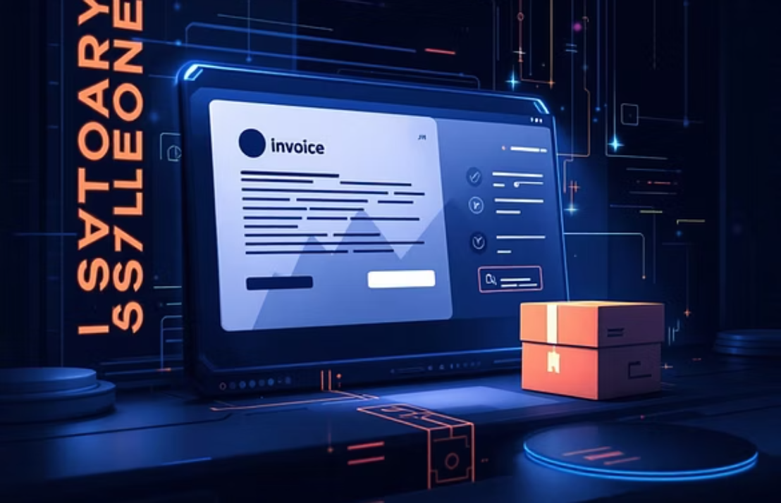
Real-World Phishing Examples
Phishing attempts are constantly evolving. Here are some common scenarios you might encounter, designed to look authentic.
These examples highlight how sophisticated attackers have become, making it critical to stay vigilant and scrutinize every detail.
Made by Badar

Slide 9

Best Practices: Avoiding Phishing
Empower yourself with these essential habits to safeguard against phishing and maintain a secure online presence.
Think Before Clicking
1
Always pause and consider the legitimacy of an email or message before interacting with any links or attachments.
Verify the Sender
2
If something feels off, independently verify the sender's identity through official channels, not by replying to the suspicious message.
Strong Passwords & MFA
3
Use unique, complex passwords for each account and enable Multi-Factor Authentication (MFA) wherever possible for an extra layer of security.
Keep Systems Updated
4
Regularly update your operating system, web browsers, and security software to protect against known vulnerabilities.
Made by Badar

Slide 10



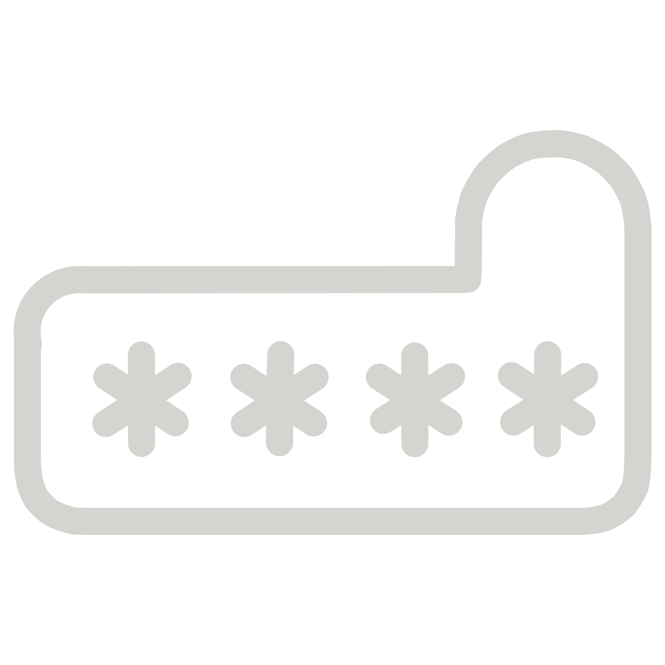
Suspect Phishing? Act Now!
If you encounter a suspicious message, your actions (or inactions) can make a significant difference. Follow these steps immediately.
Do Not Engage
Do not click on any links, open attachments, or reply to the message. This prevents further compromise.
Report to IT/Security
Forward the suspicious message to your organization's IT or security team immediately for investigation.
Delete the Message
Once reported, delete the phishing email or message to prevent accidental future interaction.
Change Passwords
If you suspect you may have clicked a link or entered credentials, change your passwords for affected accounts immediately.
Made by Badar

